Slide 1
AI
PROJECT PO
Venceslas KOUASSI
Lucas BONMARIN

Slide 2
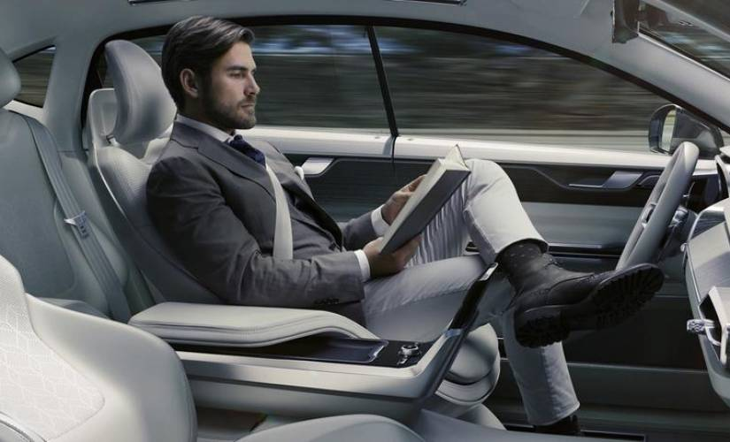
TOPIC
2
AI Applications in Autonomous Vehicles
Source

Slide 3
PLAN
4
AUTONOMOUS VEHICLE : WHAT IS IT ?
EXISTING SOLUTIONS
EXISTING COMPANIES
CURRENT LIMITATIONS & HARD PROBLEMS
EXAMPLES OF ETHICAL CONSIDERATIONS

Slide 4
AUTONOMOUS VEHICLE : WHAT IS IT ?
5
A vehicle that can guide itself without human conduction.
Vehicle using automation for difficult tasks = semi-autonomous
Vehicle relying solely on automation = autonomous.
Different levels of Autonomy
0
No Automation
1
Driver assistance
2
Partial automation
3
4
5
Conditionnal Automation
High Automation
Full Automation

Slide 5
EXISTING SOLUTIONS
6
Adaptive cruise control
Shared autonomous vehicles
Focus has been on low speed, 20 miles per hour (32 km/h), with short, fixed routes for the "last mile" of journeys
Motorcycles
Buses
Cars
Intelligent Parking Assist System
Automotive night vision with pedestrian detection
Driver Monitoring System
Several self-balancing autonomous motorcycles were demonstrated in 2017 and 2018 from BMW, Honda and Yamaha
Autonomous buses are started to be used in Stockholm.
China has also a small fleet of self-driving public buses in the tech district of Shenzhen, Guangdong.
Local Motors ("Olli") and the Gateway project.
Advanced Automatic Collision Notification, such as OnStar

Slide 6
EXISTING SOLUTIONS
6
Caterpillar Inc. made developments in 2013 to improve efficiency and reduce cost at various mining and construction sites
Drones
Delivery drones for various industries, including packages and food
Trains
Others
Trucks
First self-driving train in UK was launched in London Thameslink route.
Automated Guided Vehicle
Aicraft
Watercraft
Submersibles
week of autonomous driving across Europe in April 2016, by trucks from Volvo and the Daimler Company
Main issue : legislation
An example of automated trains is the Docklands Light Railway in London.
traditional transportation companies compete with start-ups, governments and technological companies like Amazon, on this market

Slide 7
EXISTING COMPANIES
8
March 2018, Waymo, the automated vehicle company spun off from Google parent company Alphabet Inc., announced it was applying its technology to semi trucks.
Uber Semi
Tesla Semi
Waymo Semi
Our self-driving semi trucks are already in the road in Arizona
In November 2017 Tesla, Inc., owned by Elon Musk, revealed a prototype of the Tesla Semi and announced that it would go into production
Starsky Robotics
In 2017, Starsky Robotics unveiled its technology that allows to make trucks autonomous.
Notes:
Pour comprendre le concept de SAC, Bernoux s’est penché sur trois axes majeurs au nombre desquelles figure la psychologie individuelle.

Slide 8
EXAMPLES OF ETHICAL CONSIDERATIONS
9
Extreme cases: kills a group of pedestrians or plunge of a cliff?
How a car should decide between the lives of its passengers and those of pedestrians?
If there’s an accident, who can we blame? The constructor? The engineer or the vehicle?
Notes:
Pour comprendre le concept de SAC, Bernoux s’est penché sur trois axes majeurs au nombre desquelles figure la psychologie individuelle.

Slide 9
CURRENT LIMITATIONS & HARD PROBLEMS
13
One of the current limitations for vehicular automation was the electrical power required to run the processors.
How do we store the huge amont of data?
Balance between speed and the safety on the road (Pedestrians, other vehicles, etc. )
How to avoid random noise?
Notes:
Pour comprendre le concept de SAC, Bernoux s’est penché sur trois axes majeurs au nombre desquelles figure la psychologie individuelle.

Slide 10
CURRENT LIMITATIONS & HARD PROBLEMS
13
Creating and maintaning maps for self-driving cars is difficult work
Transition to autonomous vehicles : Driving requires many complex social interactions !
Bad weather makes everything trickier.
Notes:
Pour comprendre le concept de SAC, Bernoux s’est penché sur trois axes majeurs au nombre desquelles figure la psychologie individuelle.

Slide 11

CONCLUSION
END
17

Slide 12
REFERENCES
19
Wikipedia, Vehicular Automation, https://en.wikipedia.org/wiki/Vehicular_automation#cite_note-3
Techopedia, Autonomous Car, https://www.techopedia.com/definition/30056/autonomous-car
https://www.vox.com/2016/4/21/11447838/self-driving-cars-challenges-obstacles?fbclid=IwAR3_GQOXtSetCRvRulJGJeTpT3gKtOynQzlMMoRjF7GeGY179vVS8CInIZo
https://theconversation.com/the-everyday-ethical-challenges-of-self-driving-cars-92710?fbclid=IwAR0V12DO0mVZ9Ooa7R85piI2YJkUea5iQiIzuKp8FhqJZ4peY1CPYVr-7-Y

